Slide 1
Reading Age Model Update 15/4/2021

Slide 2
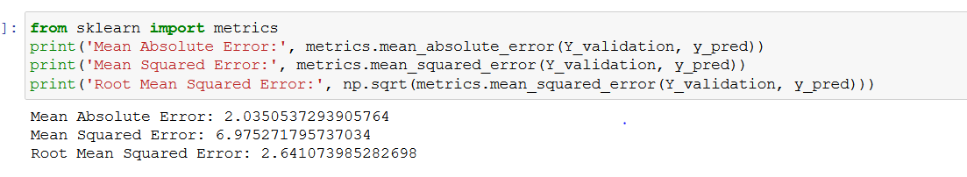
Option 1- Predict RA using number of words per page and a linear regression model

Slide 3
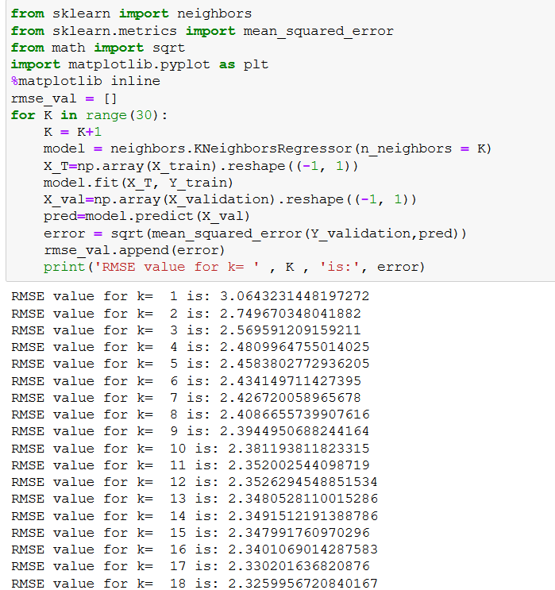
Option 2- Predict RA using number of words per page and a KNN model

Slide 4
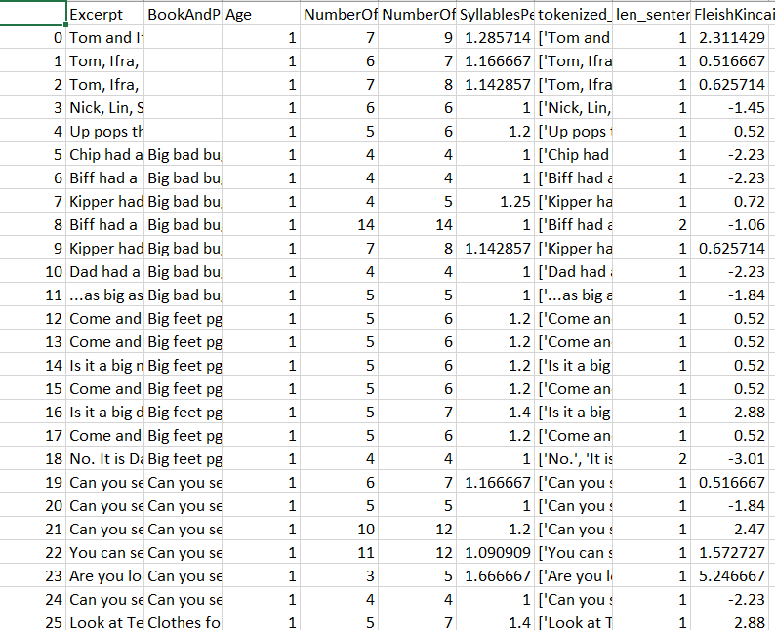
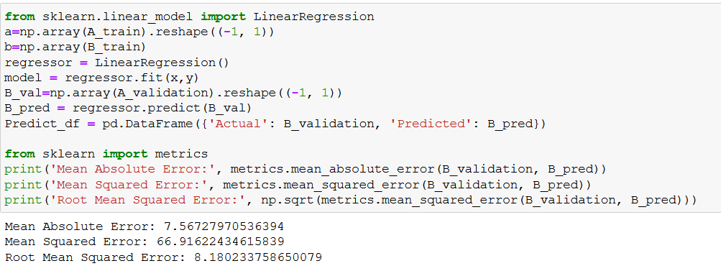
Option 3- Use Flesh Kinkaid model

Slide 5
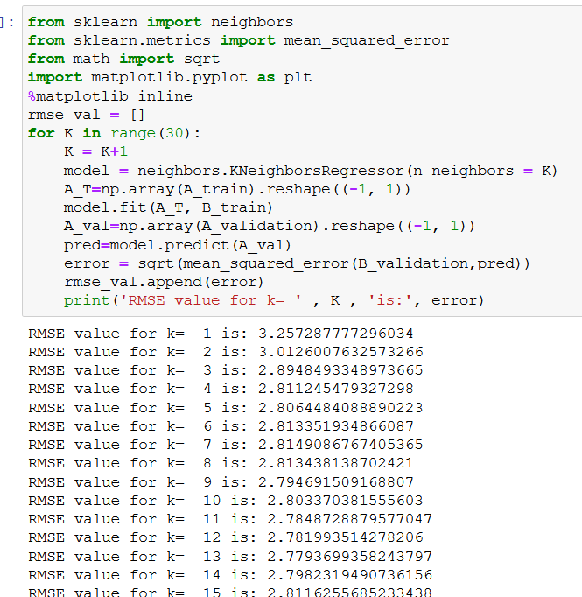
Option 3- Use Flesh Kinkaid model

Slide 6
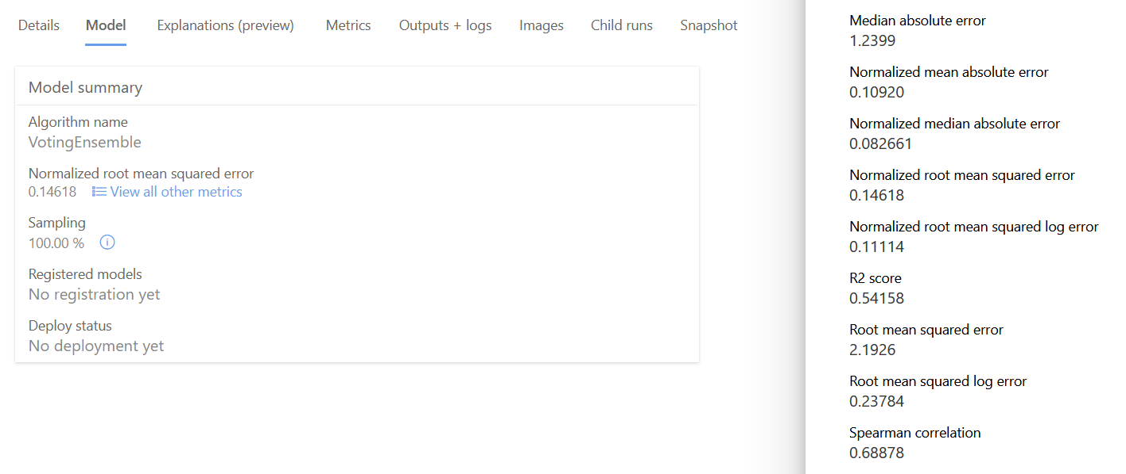
Option4- Use Microsoft Azure Machine Learning

Slide 7
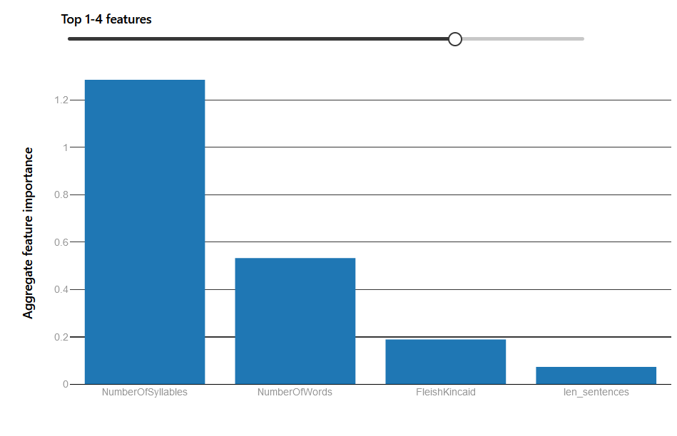
https://docs.microsoft.com/en-us/azure/machine-learning/how-to-use-automated-ml-for-ml-models

Slide 8
How to improve models- Look at the raw data
RA3

Slide 9
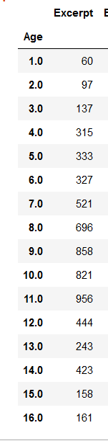
How to improve models- Do we need more data?
For early reading ages you are looking at between 2 and 20 words a page. Slight differences can lead to very different predictions

